Slide 1
The 4 Deadly Sins of Mentorship
#KCDC16 6.23.2016
Christina Aldan, TEDx Speaker and Entrepreninja
@luckygirliegirl
IAmAGoodMix.com
LGDesigns.co
LG@LGDesigns.co
702.900.3419

Slide 2

Thank You!

Slide 3





































TITANIUM SPONSORS
Platinum Sponsors
Gold Sponsors

Slide 4
My 1st Mentor
“Experiences are the sum total of who we are, but not of what we can become.”
Betty Chavis
Notes:
I’ve had a lot of mentors in my life. This quote comes from my first mentor, Betty Chavis. Back when I was in college, I worked in the Chemistry Department. I was insecure and uncertain. I was just the gopher, basically.
So one day, I was supposed to go to the Cultural Diversity Office and I had never been there before. I thought I’d been everywhere on campus, but I had never been to the diversity office and I had to ask directions a few times along the way.
So eventually I found myself walking down this looooon corridor in the basement of the School of Business. So there I was, 20 years old and shy Christina (if you can imagine that), walking, turning down these hallways and stopping for directions along the way until finally I found the spot. So I very timidly peeked in to the office and I’d never seen anything soooo…. Inspiring. I peeked into the office and there were stacks of books, magazines and papers everywhere. The shelves were covered in bright colored flags and talismans and statues from all over the world. And sitting in the middle of it all was Betty Chavis.
“Well what are you doing standing out there? Come on in!”
“Hi, um…” I cleared by throat.
“How can I help you today?” “Hi, um, I’m from the Chemistry department and I need your signature, pls”
She signed my document, then put it back into the manila interdepartmental envelope.
I turned to creep away.
“Well, now I don’t believe we have ever met. What is your name?” She caught me off guard? Did she mean my department head’s name? Surely she couldn’t be interested in lil ‘ol me.
“My name?”
“Yes, what is your name?” “Chris” and I started to shrink away again. “Chris what? Well do you have a last name? Are you a student here?” She stuck out her hand and I shook it.
“Chris Coron, I mumbled. “Chemical Engineering. Pleased to meet you.” “Oh, so you are one of those smart ones in the chemical engineering department.” “I guess so.”
“Well how is your day going today?” I was taken aback by her interest in me. I was normally invisible.
“Fine, I guess.” “Well, you come back and see me again soon.”
And I did. I kept coming back. And she later helped me realize my dream of studying in the australian rainforest.
This was a quote from her that has helped me over and over again in life. Whenever I get down on myself or impatient with my progress or frustrated at a bad decision I’ve made or guilty about my poor choices in my 20’s, I remember this quote from my very first mentor, Betty Chavis.
Mentorship can come from people in the same industry, people of varying ages and through various communication methods (in-person, email, video conferencing, etc.). Mentorship experiences can happen once or multiple times throughout the year. Mentorship is more about guiding others through challenging experiences that you’ve already experienced than it is about telling someone what to do.
Mentorship is a two-way street.
Mentorship is a win-win scenario.
And today we are going to talk about the 4 deadly sins of mentorship

Slide 5

What is Mentorship?
A relationship in which a more experienced or more knowledgeable person helps to guide a less experienced or less knowledgeable person.
Notes:
Mentorship is important to build into your organization. In order to maintain a cohesive culture of your organization, you must pass on a legacy. Mentorship allows you to impart values, creates a cohesive culture and shares experiential wisdom. Creating a caring, diverse, supportive environment allows your team to build the skills and attitudes they need for success. In this presentation, you will learn the Four Deadly Sins of Mentorship that will make or break your organization.

Slide 6
Why is it Important?
Legacy
Relevancy
Avoiding Mistakes
Honest Feedback
Long-lasting Friendship
Employee Retention
Strengthen Teams
Notes:
Legacy – It’s important to leave a legacy of your work
Relevancy - I keep up with current trends through my mentees since several of them are younger than me
Avoiding Mistakes
Honest Feedback
Long-lasting Friendship
Employee Retention
Strengthen Teams

Slide 7
Expand Your Views Of Mentorship
Mentors guide you by teaching through their experiences
Meet 1-on-1 once a year for coffee
Follow their tips and suggestions by regularly following their books, newsletters, blog and social media
Quarterly Skype call
Different age, industry, gender, religion
Signed agreement and timeline (optional)
Notes:
Traditional views of mentorship might tell you to have no more than 3 mentors and to follow everything they do so you essentially become a carbon copy of your mentor. I take in advice from a diverse group of mentors and I trust my own emotional intelligence to filter out any information that doesn’t work for me. Today I’d like to invite you to expand your views of Mentorship. Mentors come in many forms. Maybe you meet with them once a year 1-on-1, maybe you follow them on social media, maybe they are younger or older than you. Maybe they are in different industries. You would be surprised to learn the people I take advice from. Here is a near-complete list of the people I accept support from. These people help guide me and show me the way into my pain and out the other side:

Slide 8
My Mentors
The Astrologer
The Angel Incarnate
The Nurturer
The Genius
The Writer
The Lost Japanese Princess
The One-Who-Guards-the-Portal-To-The-Earth
The Christian (actually, I’ve got a few of these trusted teachers in my life.)
The Yogi
The Teacher
The Buddhist
The Jewish Chinese Medicine Doctor
The Sicilian Mermaid
The Businessman
The Brain-Based Guy
The Beatnik
Notes:
The Astrologer
The Angel Incarnate
The Nurturer
The Genius
The Writer
The Lost Japanese Princess
The One-Who-Guards-the-Portal-To-The-Earth
The Christian (actually, I’ve got a few of these trusted teachers in my life.)
The Yogi
The Teacher
The Buddhist
The Jewish Chinese Medicine Doctor
The Sicilian Mermaid
The Businessman
The Brain-Based Guy
The Beatnik
They all contribute to shaping who I am and how I think and rethink my own perspectives, regardless of whether I accept any of their specific view into my value system or not. Sometimes, when comparing the input of different mentors, I might notice that the words and symbols are different, but the intention and the meaning are the same.
Diversity and Inclusion are as important today as they have ever been. When you respect another’s world view (I’m not saying you have to completely agree with their worldview), you form a deeper connection with them on a more humane level. You expand your ability to empathize.
How do you choose the people who support you? Look around at your own tribe. Are you consulting a broad range of thoughtful perspectives? Is it time to diversify? [#6 find diverse mentors]

Slide 9
The Four Deadly Sins of Mentorship
1 Trying to guilt or shame mentees
2 Dictatorship ≠ Mentorship
3 Motivating with Bribes
4 Telling them what they want to hear
Notes:
I have a lot of different mentees, from age 16 to 68. High school students, startup founders, re-inventors, non-profits, solopreneurs, college kids. They all have one thing in common: they are open to learning from my experiences.

Slide 10
1 • Trying to guilt or shame mentees.
Guilt
Free
Zone
In business, It’s important to teach skills for good business acumen.
Navigating office politics is not a subject taught in class.
Notes:
1Trying to guilt or shame mentees. Guilt and shame are unpleasant. Trying to guilt or shame a mentee into doing what YOU think is best for them does not create positive transformation. Rather than exacerbate a mentee’s feelings of guilt or shame around an event, help them transform their feelings about a situation. There are techniques such as Neurolinguistic Programming (NLP) to help mentees work through feelings of guilt and shame by acknowledging that the brain’s neuroplasticity allows us to create new neuropathways and transform feelings of guilt and shame around a situation.

Slide 11

Instead: Teach it, Don’t preach it!
Source: www.livebinders.com

Slide 12
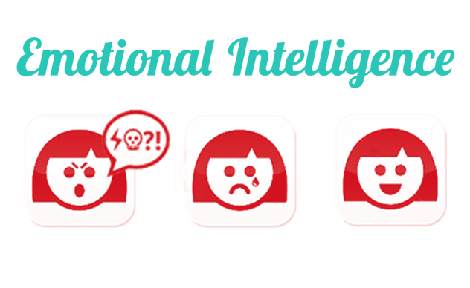
What is EQ?
Notes:
Has anyone heard of emotional intelligence lately?
It’s kind of a buzzword floating around right now.
They have broken it down into 4 parts.

Slide 13
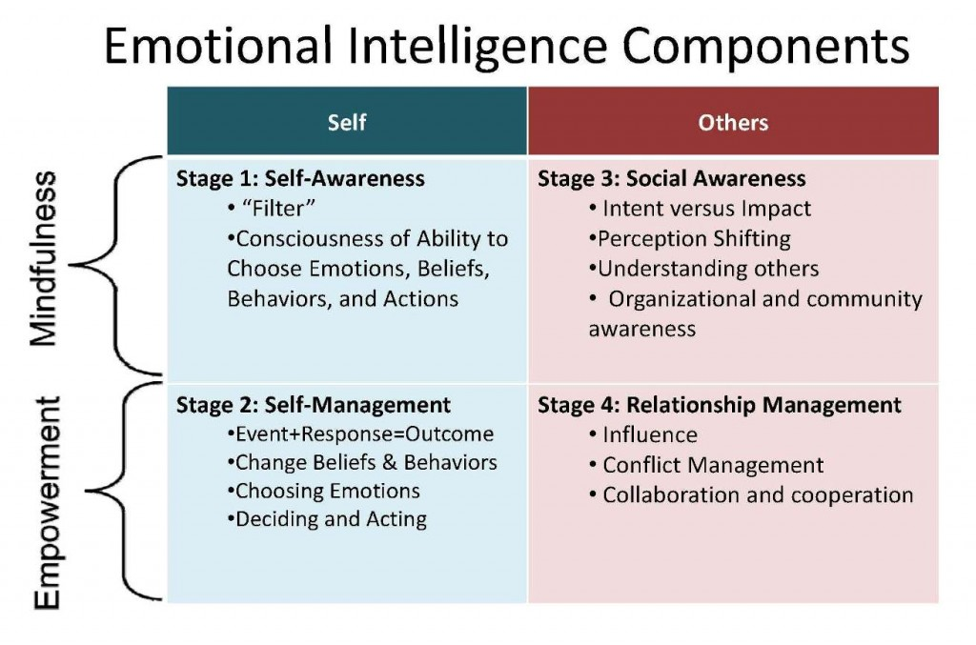
4 Components of Emotional Intelligence
Source: http://reconstructingeve.com/eq

Slide 14
The 4 components of Emotional Intelligence
Mindfulness of Self
Mindfulness of Others
Self-Management
Relationship Management
Build Your Tribe
Notes:
The 4 components of Emotional Intelligence
Mindfulness of Self
Mindfulness of Others
Self-Management
Relationship Management
Build Your Tribe
Can you see how this would be important for success in mentorship?
Do you wish someone at work would have a higher EQ?

Slide 15
Ingredients for Implementing EQ
A Desire to Improve Relationships
EQ Workshops
EQ Trainings
1-on-1 Coaching
Practice
Track Progress

Slide 16

Help Them Build Emotional Intelligence (EQ)
Notes:
I mean, once I started exploring and learning more about neuroplasticity of the brain. Between my life coach, my business coach, my acupuncturist and personal trainer, it took 2.5 years, but I have been able to reprogram of the thought patterns my brain. I am on time now, or early. I sleep 8 hours a night. I eat 3 meals a day. I spend time with my friends. And I am surprisingly still effective. Now I have been slacking at the gym lately, but I’m allowed to take some time off. We all are. Just as long as you understand that your physical health is integrated with your emotional health and spiritual health. Help others increase their emotional intelligence and

Slide 17
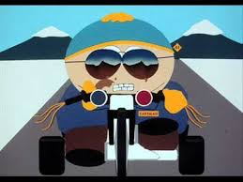
2 • Dictatorship ≠ Mentorship
Notes:
2 Dictatorship is not a mentorship. Often times mentors will be tempted to replace guidance with dictation. If a mentee is not doing what the mentor THINKS they should be doing, there might be a tendency to try to control the other person’s behavior. Consider your influence when offering guidance to others. There are many factors that influence a person’s response, such as how much they respect you, if they have fear of disappointing you, etc. Any living organism will naturally choose to take the path of least resistance (well, if I’m being honest some of us often choose to do things the HARD way. Hehe.). People will have the tendency to want to avoid of sabotage any interactions that are not pleasant. A Dictatorship is not the same thing as a mentorship. Mentees will tend to avoid dictators if they feel they aren’t getting anything useful from the relationship. (dictators’ photos) Remember, a mentor guides others towards their goals by sharing their own experiences with them.

Slide 18
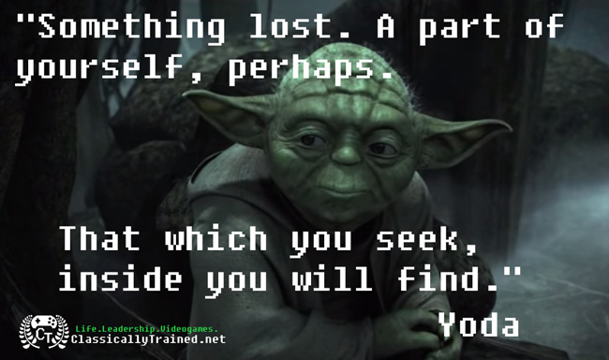
Instead: Mentors are guides

Slide 19

3 • Motivating with Bribes
Notes:
3 It used to be that you worked at a company for your entire life then retired. Those days are gone. People want to feel connected, engaged and involved. Purpose is just as important as a paycheck in order to stay motivated and engaged. Mentors can sometimes try too hard to motivate mentees using monetary rewards or gifts. These might work temporarily, however, helping to guide the mentee into understanding their true purpose and their passion for success will create lasting motivation.

Slide 20
Instead: Become a Talent Detective
Uncover their best talents.
Motivate using their passions.
Remember, you are a guide to help them on their career path.
Notes:
Story about the girl in the store clerk. Who is going to do you? What are you passionate about? While I have experienced many types of mentorships, I find myself drawn towards relationships that are in alignment with my own passions.

Slide 21

4 • Telling them what they want to hear
Help them step outside their comfort zone.
That’s where the magic happens.
Unicorns!
Fun!
Magic!
Rainbows &stuff!
Our
Comfort
Zone
Notes:
4 Telling them what they want to hear. Growth happens when we feel uncomfortable. Living organisms will almost always take the path of least resistance. So we must be pushed outside their comfort zone in order for growth to occur. Mentees will not advance in their career if they are never challenged. Giving them lip service by telling them what you think they want to hear is a waste of time for both of you.

Slide 22
Instead: Be Honest, but be Kind
“Tell yourself the truth in the kindest way possible”
~Nancy Gabriel

Slide 23
Mentor Fatigue
If you are the mentee:
Be concise
Be engaged
Be proactive
If you are the mentor:
Know your boundaries
Set clear mentor hours
Communicate clearly

Slide 24
Overall: Mentors Inspire
A life well-lived is the best gift that you can give.
Notes:
If you are a Mentor or considering becoming a mentor, you should use your own enthusiasm to help inspire those around you to live their best lives. A life well-lived is the best gift that we can give.

Slide 25
Questions
Christina Aldan,
TEDx Speaker and Entrepreninja
@luckygirliegirl
IAmAGoodMix.com
LG@LGDesigns.co
702.900.3419

